Slide 1
BlockCHAIN (DLT: DISTRIBUTED LEDGER TECHNOLOGY) BASED CRYPTOCURRENCY WITH FURTHER IMPLEMENTATION OF SMART CONTRACTS
Submitted for:
VOID HACKS 2019
SVVV, INDORE
Submitted by:
Team HACK O’ HOLICS
SVVV, INDORE
4/7/19
1
Notes:
7

Slide 2

Blockchain Disruption starts with committing to excellence and taking a stand for your community
“The blockchain is an incorruptible digital ledger of economic transactions that can be programmed to record not just financial transactions but virtually everything of value.”
-Don & Alex Tapscott, authors Blockchain Revolution (2016)
01
02
03
04
05
Immutable
Blockchains are designed to be immutable. Once a block is
Secure
Data in the blockchain is
Transparent
Decentralized
The decentralized nature of blockchain technology means that it doesn't rely on a central point of control. Lack of any single
Use Cases
A recent study surveying
The transparency of a
secured cryptography stored
through and are using
blockchain stems from the fact
over three
thousand
written to a blockchain,
that the holdings and
executives has shown that at least eighty percent are actively using, or planning
realistically, it cannot change.
Immutability has the potential
transactions of each public address are open to viewing. This level of transparency has not existed within financial systems before, especially in regards to large businesses, and adds a degree of accountability that has not existed to date
sophisticated math and
to transform the auditing
innovative software
centralized authority
to implement, some
process into a quick, efficient,
rules that are extremely difficult for attackers to manipulate and tamper
makes the system fairer and considerably more secure
aspect of blockchain
and cost-effective and bring more integrity
procedure, trust and
technology into their
everyday business.
Notes:
7

Slide 3
Blockchain Based Cryptocurrency
Better Understanding of What is Block
Hashing and it’s Techniques (SHA 256)
Mining a Block in a Blockchain(Complete Procedure)
Role of NONCE in Mining.
Blockchain has few fundamentals (Applied in Code):
Immutable Ledger
Hash Cryptography
Consensus Protocol
Distributed P2P Network
Our Code implies real time understanding of core blockchain technology, It maintains the De-Centralized Network (connect_node,replace_chain). It definitely follows Concensus Protocol.
A Cryptocurrency is said to be a Cryptocurrency when Transactions occur in blockchain network, and Concensus Protocol ensures same chain among all nodes.

Slide 4
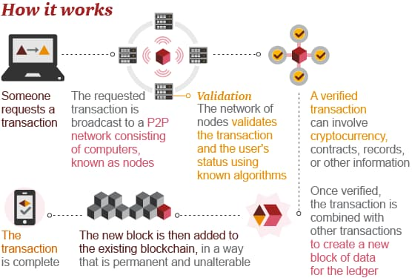

Slide 5
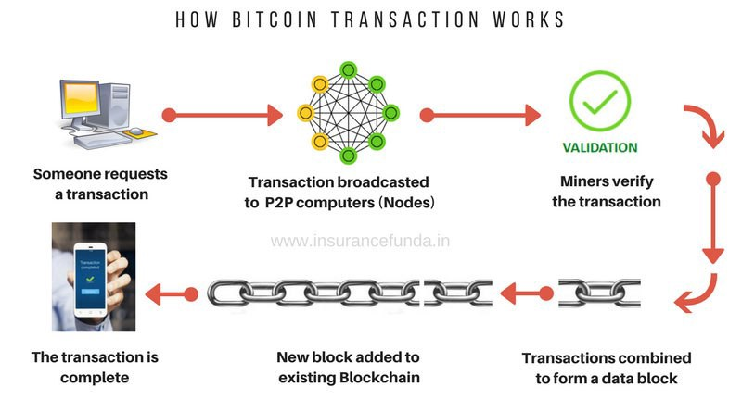

Slide 6
Compelling Blockchain “Use Cases”
Smart Contracts
Digitizing law; contractual instruments
Execute commercial transactions and agreements automatically
Smart Assets
Trade finance, supply chain, workflow, rich data
Clearing and Settlement
Greater trade accuracy, and a shorter settlement process
Short-term win with real cost savings
Payment
Reducing friction (time & cost) from the current framework ACH, SWIFT
Speed up and simplify cross-border payments
Digital Identity
Register identity; re-use that identification for other services
IoT requires IoV; IoV requires MoIP to operate; machine-to-machine commerce

Slide 7
Smart Contracts Implementation
Initial Coin Offering of 1 Lakh Coins
We fixed the rate in .sol Program (Solidity)
Different kind of functions related to transaction are present in .sol program
Ganache Truffle (Truffle Suite) : API Framework to show Block Chain Transactions.
My Ether Wallet is used for the simulation of transactions
2 Categories : Smart Contracts Implementation
Deployement of Smart Contracts
Interaction of Smart Contracts

